Slide 1

Project Presentation on
HOME AWAY
Your Ultimate Housing Solution
Guided By:
Prof. Ashish Bhise
SEAT NO. | NAME
B190594206 | Anupam Pandey
B190594218 | Yash Bambal
B190594221 | Sakshi Bhor
B190594245 | Karn Godse

Slide 2
Introduction
Motivation
Literature Review
Problem Statement
Online Survey
Objectives
System requirements
Performance and Security Requirements
System Architecture
Component Diagram
Class Diagram
Deployment Diagram
Data Flow Diagrams
User Interface
Advantages and Limitations
Applications
Conclusion
Future Scope
References
AGENDA
2

Slide 3

Introduction
Housing sector remains vigilant to face the challenges of change by employing a new strategy that facilitates easy management of rental houses . Hence there is need to develop a rental house management system that can simplify work for the rental managers so that all their work can be efficient and effective . Tenants can conveniently look for houses and their specifications while the house owners can list multiple properties along with the respective rents.
HOME AWAY- YOUR ULTIMATE HOUSING SOLUTION
3

Slide 4

Motivation
The motivation behind creating a web application like Home Away stems from a profound desire to reshape rental housing . Empowerment is key, with a user-friendly interface and extensive rental listings empowering individuals to make informed decisions. Home Away is a catalyst for positive change, promoting transparent transactions, enhancing communication, and offering a more enjoyable and efficient way to find, rent, and manage homes. Its mission is to redefine the housing market, making it accessible and harmonious for all involved.
HOME AWAY – YOUR ULTIMATE HOUSING SOLUTION
4

Slide 5
Literature Review
Sr. No. | Title | Publish Year | Authors | Findings
1. | Text Based Price Recommendation system for online Rental House | 2020 | Qianjun Liu, Gong Chen, and Shouling Ji | We analyzed the relationship between the description of each listing and its price, and proposed a text-based price recommendation.
2. | The Role of the Private Sector In House Management | 2020 | Lujia Sen,Qianjun Liu,Gong Chen and Shouling Ji | In this paper we presented TAPE, text based price recommendation system for predicting a reasonable price for newly added listings.
3. | Shop Go : An IOT Based solution 2021 for Smart Shopping | 2021 | Munchetty Ashutosh Rao | Supermarkets and shopping complexes contain a variety of products at the same place to help customers find their items easily without travelling to different places and get their items in one place.
HOME AWAY – YOUR ULTIMATE HOUSING SOLUTION
5

Slide 6
Literature Review
Sr. No. | Title | Publish Year | Authors | Findings
7. | Human Resource Management Portal | 2022 | Jesada kittivaraporg | Project aims to enhance the design and development of a Human Resource application by empowering it with an efficient and innovative communication channel using web portal.
8 | Exploring Airbnb users concerns with LDA-Based Topic Model and Sentiment Analysis | 2022 | Jingya Liu X | Techniques such as text management and sentiment analysis have been applied widely to extract useful information from social network comments.
HOME AWAY – YOUR ULTIMATE HOUSING SOLUTION
7

Slide 7

Problem Statement
Traditional property transactions are marred by inefficiencies. Real estate agents, brokers, and third-party listing websites have long been the intermediaries through which individuals seek rental or sale properties. This middleman-heavy approach not only adds unnecessary costs but also creates barriers in communication between property seekers and owners. These obstacles can lead to confusion, miscommunication and extended timelines.
HOME AWAY – YOUR ULTIMATE HOUSING SOLUTION
8

Slide 8

Online Survey
We have gone through various popular similar web applications to do the current market analysis to find the best rental property for tenants or for owner to get the best tenant with faithfulness at its best and analyze the scope of improvements to the field. We propose these enhancements that we hope to make to our website after analyzing other online projects comparable to our project:
Better User Interface and User Experience
A responsive website that will deliver an excellent user experience.
Satisfying the conditions for owner as well as for tenant.
Easy way of payment.
Track of previous records and transactions.
Transparency in documents.
HOME AWAY- YOUR ULTIMATE HOUSING SOLUTION
9

Slide 9

Objectives
To Simplify the rental process by centralizing housing needs in a user-friendly platform.
To Enhance transparency and security through online
creation and management of rental agreements.
To Facilitate seamless communication between landlords and
tenants via a built-in messaging system.
To Offer convenience and efficiency with an intuitive interface and extensive rental listings.
To Promote peace of mind throughout the rental process by
addressing associated challenges.
HOME AWAY – YOUR ULTIMATE HOUSING SOLUTION
10

Slide 10

System Requirements
Minimum Hardware Requirements
Laptop or PC
Pentium 4 or newer processor that supports SSE2
Mac - Mac computer with an Intel x86 or Apple silicon
processor
512MB of RAM / 2GB of RAM for the 64-bit version
200MB of hard drive space
HOME AWAY – YOUR ULTIMATE HOUSING SOLUTION
11

Slide 11

System Requirements
Minimum Software Requirements
For User
Browsers: Microsoft Internet Explorer, V9 or later. Mozilla Firefox, V29 or later. Chrome, V34 or later.
Used For Development
Visual Studio Code
ReactJs libraries
NodeJS
HTML
CSS
Javascript
HOME AWAY – YOUR ULTIMATE HOUSING SOLUTION
12

Slide 12
Performance and Security Requirements
PERFORMANCE REQUIREMENTS
Stable internet connection is required to use the application as it has some functionalities which requires a
stable internet connection.
As the applications contain a large amount of data in the database, sufficient memory is required. SECURITY REQUIREMENTS
The database and the physical view of the system will remain hidden from the users , only an admin or the developer can view the back-end of the system.
User authorization and data encryption are important security requirements of the system.User stream should not be available to anyone who is not authorized by the user of the device.
The database is encrypted by a password. Any unauthorized user cannot access , update or manipulate the
database.
HOME AWAY - YOUR ULTIMATE HOUSING SOLUTION
13

Slide 13

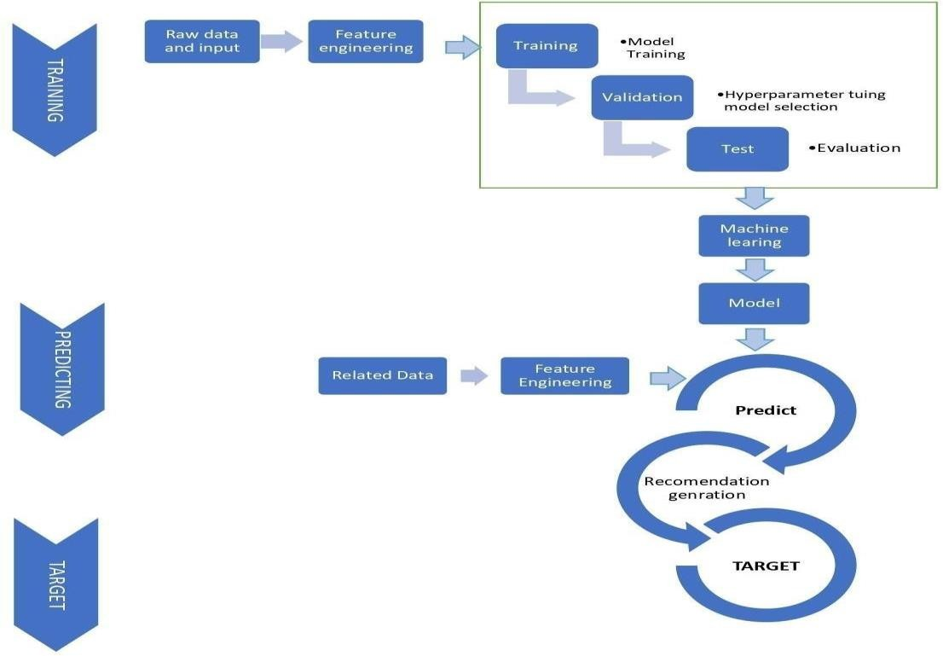
System Architecture
Architectural Flow and Design of our
project: Algorithm Visualization
The given Diagram maps out the physical implementation for components of the software system.
HOME AWAY – YOUR ULTIMATE HOUSING SOLUTION
14

Slide 14

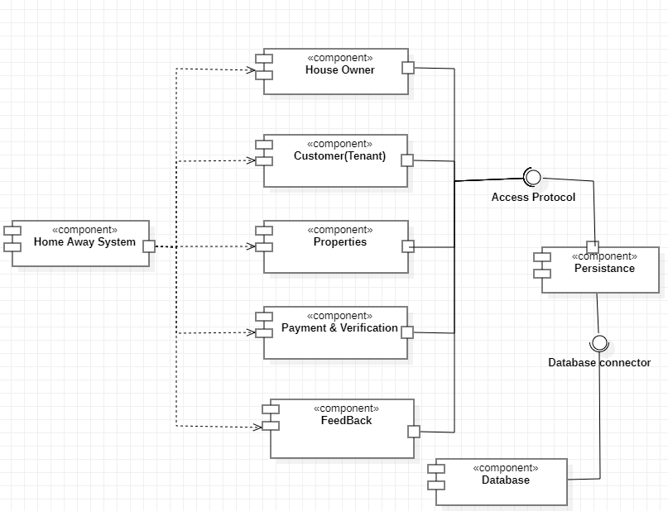
UML Diagrams
Component Diagram
VISUALIZATION AND COMPARATIVE SIMULATION OF PATHFINDING, SEARCHING AND SORTING ALGORITHMS
15

Slide 15

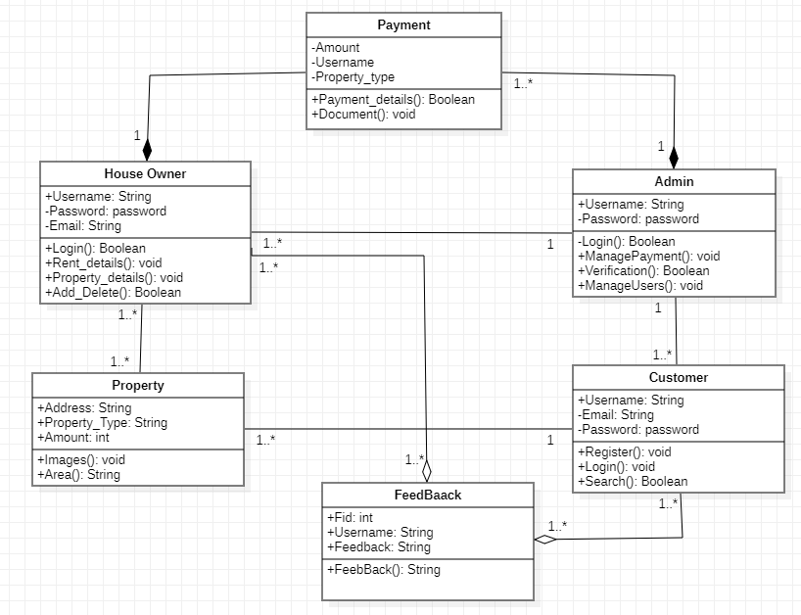
UML Diagrams
Class Diagram
HOME AWAY – YOUR ULTIMATE HOUSING SOLUTION
16

Slide 16

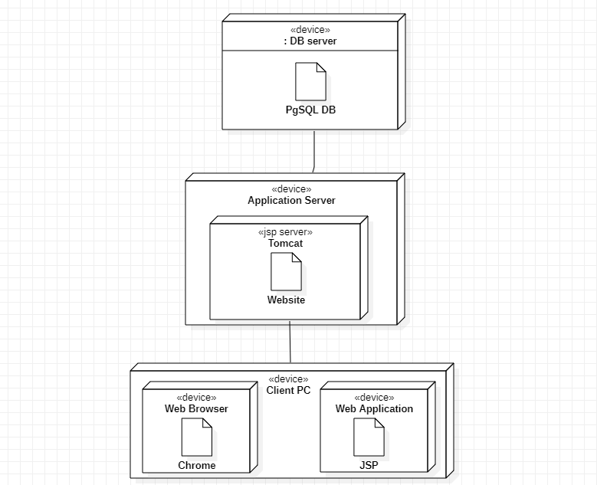
UML Diagrams
D e p l o y m e n t D i a g r a m
HOME AWAY – YOUR ULTIMATE HUSING SOLUTION
17

Slide 17

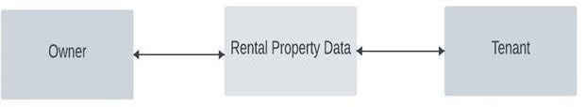
Data Flow Diagrams
Data Flow Diagram
- Level 0
HOME AWAY – YOUR ULTIMATE HUSING SOLUTION
18

Slide 18

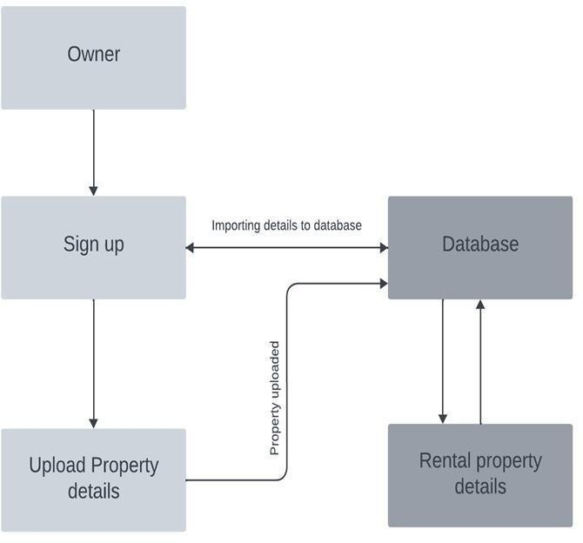
Data Flow Diagrams
Data Flow Diagram - Level 1
HOME AWAY – YOUR ULTIMATE HUSING SOLUTION
19

Slide 19

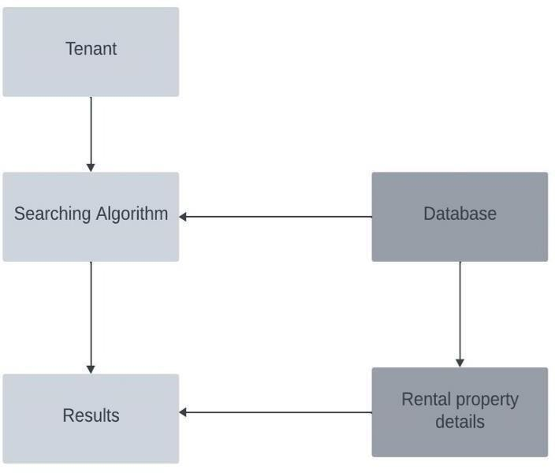
Data Flow Diagrams
Data Flow Diagram - Level 2
HOME AWAY – YOUR ULTIMATE HUSING SOLUTION
20

Slide 20

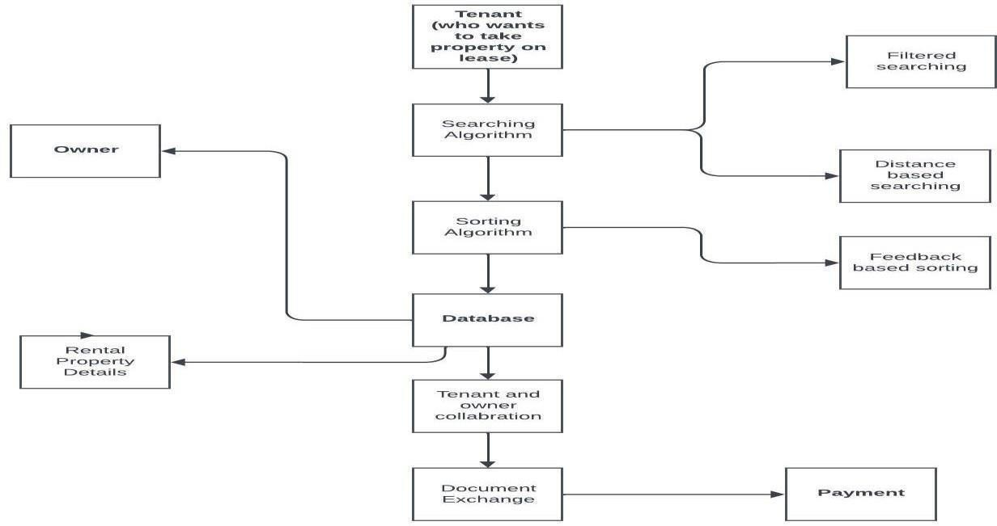
Data Flow Diagrams
Data Flow Diagram - Level 3
HOME AWAY – YOUR ULTIMATE HOUSING SOLUTION
21

Slide 21

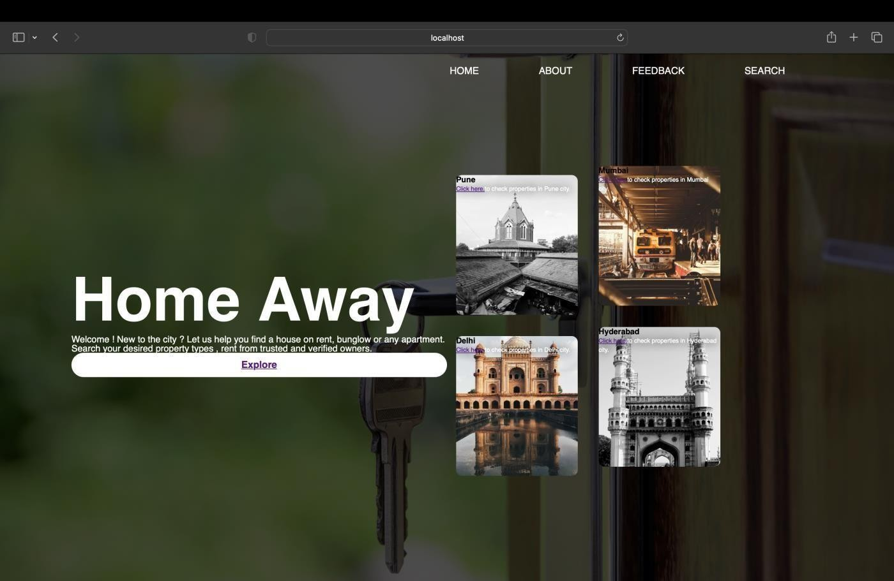
User Interface - HomePage
HOME AWAY – YOUR ULTIMATE HOUSING SOLUTION
22

Slide 22
Advantages and Limitations
Advantages Limitations
Provides most up-to-date content  Works only with Internet
Effective than conventional methods
The system can be more efficient if deployed on distributed servers
Dynamic working of distinct algorithms
Accommodates everyone’s needs
Users can understand the topic without
prior knowledge.
HOME AWAY – YOUR ULTIMATE HOUSING SOLUTION
23

Slide 23
Applications
This application will engage and keep learners motivated with their subjects of study.
Adding interactive games and mazes with algorithms will result in Gamified Algorithm
Learning.
.
Students and Corporate Trainees will be able to get knowledge on various algorithms
This application will make it easy for trainers or teachers to demonstrate the above- mentioned algorithms.
This application will help users to better understand the real-world applications of these
algorithms.
HOME AWAY – YOUR ULTIMATE HOUSING SOLUTION
24

Slide 24
Conclusion
In conclusion, the software can be used as an inventory system to provide a framework that enables the managers to make reasonable transactions made within a limited time frame. Each transaction made on the system go hand in hand with the data being updated in the database which is the back end
.
HOME AWAY – YOUR ULTIMATE HOUSING SOLUTION
25

Slide 25
Future Scope
The testing approaches can be automated for easy, efficient and accurate software testing.
The user interface can be made more user friendly after receiving the feedbacks and suggestions from the users who are currently using the application.
Security can be made more advanced by adding into more techniques.
The payment module can be converted into a real working module by connecting the admin account to a bank and completing the necessary procedures.
Backup can be automatically maintained.
Increasing the size of the database, by adding many more house owners and properties,thus widening the reach of the users.
HOME AWAY – YOUR ULTIMATE HOUSING SOLUTION
26

Slide 26
References
K.G.Derpanis,Mean shift clustering, Lecture Notes, http://www.cse.yorku.ca/%7Ekosta/CompVis Notes/mean shift.pdf,
2005
D. Comaniciu and P. Meer, Mean shift: A robust approach toward feature space analysis, IEEE Transactions on Pattern Analysis & Machine Intelligence, vol. 24, no. 5, pp. 603–619, 2002.
J. Pennington, R. Socher, and C. Manning, Glove: Global vectors for word representation, in Proc. of the Conference on Empirical Methods in Natural Language Processing (EMNLP), Doha, Qatar,2014, pp. 1532–1543.
J. Gallin, The longrun relationship between house prices and rents, Real Estate Economics, vol. 36, no. 4, pp. 635–658, 2008.
P. Choudhary, A. Jain, and R. Baijal, Unravelling Airbnb predicting price for new listing, arXiv preprint arXiv:1805.12101, 2018.
G. K. Tso and K. K. Yau, Predicting electricity energy consumption: A comparison of regression analysis, decision tree
and neural networks, Energy, vol. 32, no. 9, pp. 1761–1768, 2007.
HOME AWAY – YOUR ULTIMATE HOUSING SOLUTION
27

Slide 27
References
J. Gallin, The longrun relationship between house price and rents, Real Economics, vol. 36, no. 4, pp. 635– 658, 2008
E. Tang and K. Sangani, Neighborhood and price prediction for San Francisco Airbnb listings, http:// cs229.stanford.edu/proj2015/236 report.pdf, 2018
A. Vaswani, N. Shazeer, N. Parmar, J. Uszkoreit, L. Jones, A. N. Gomez, L. Kaiser, and I. Polosukhin, Attention is all you need, in Proc. of the Advances in Neural Information rocessing Systems, Long Beach, CA, USA, 2017, pp. 5998–6008.
K. Fukunaga and L. Hostetler, The estimation of the gradient of a density function, with applications in
pattern recognition, IEEE Transactions on Information Theory, vol. 21, no. 1, pp. 32–40, 1975.
5. S. Arora, Y. Liang, and T. Ma, A simple but tough-to-beat baseline for sentence embeddings, presented at International Conference on Learning Representations, Palais des Congres Neptune, Toulon, France, 2017.
HOME AWAY – YOUR ULTIMATE HOUSING SOLUTION
28

Slide 28
Thank You !!
31

